Slide 1
Lecture 6
Nonlinear Relationships and Transformation

Slide 2



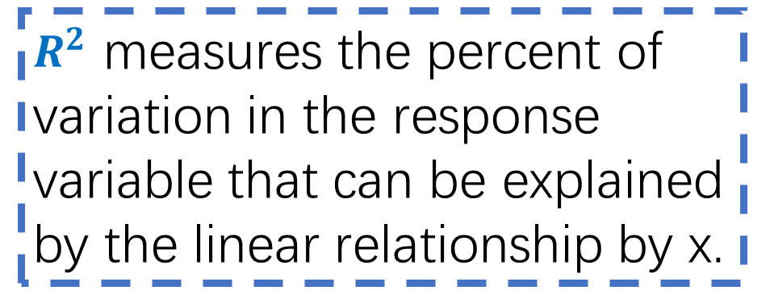
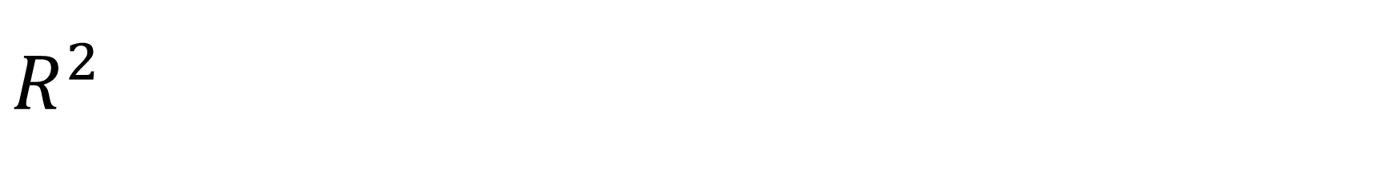
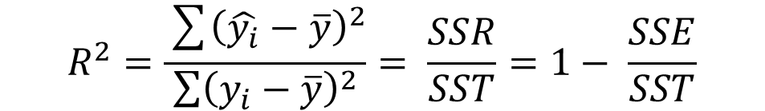
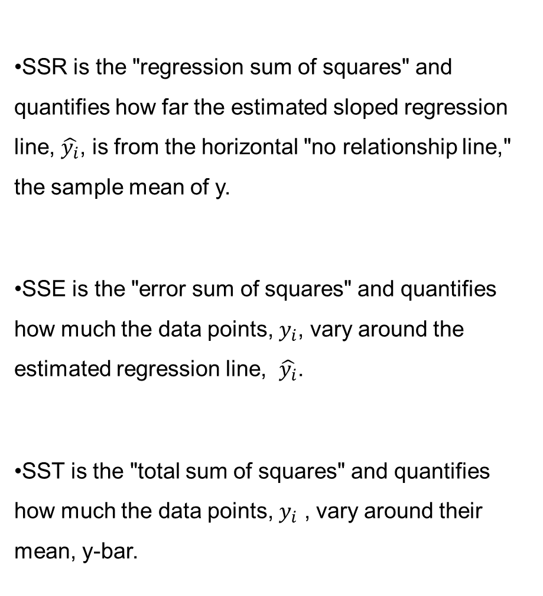
$$R^{2}$$
SSR is the "regression sum of squares" and quantifies how far the estimated sloped regression line, $\hat{y_{i}}$, is from the horizontal "no relationship line," the sample mean of y.
SSE is the "error sum of squares" and quantifies how much the data points, $y_{i}$, vary around the estimated regression line, $\hat{y_{i}}$.
SST is the "total sum of squares" and quantifies how much the data points, $y_{i}$ , vary around their mean, y-bar.
$$R^{2}=\frac{\sum{{\left(\hat{y_{i}}−\overline{y}\right)}^{2}}}{\sum{{\left(y_{i}−\overline{y}\right)}^{2}}}= \frac{SSR}{SST}=1− \frac{SSE}{SST}$$
$R^{2}$ measures the percent of variation in the response variable that can be explained by the linear relationship by x.

Slide 3
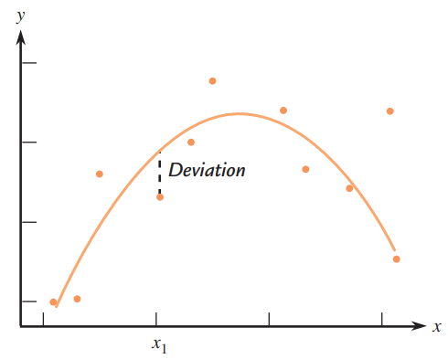
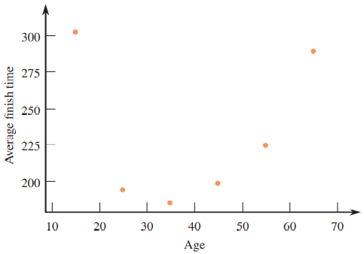
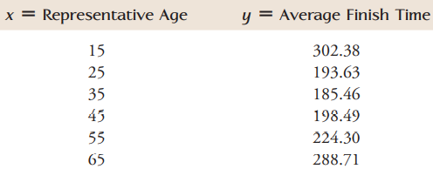


Nonlinear Relationships and Transformation
Polynomial Regression
Example: Age & Marathon finish time
It is clear that no straight line can do a reasonable job of describing the relationship between x and y.
Min $\sum{{(y_{i}−\hat{y_{i}})}^{2}}$
Choose values for a,b1,b2 in the quadratic function so that the sum of squared deviations is as small as possible.

Slide 4
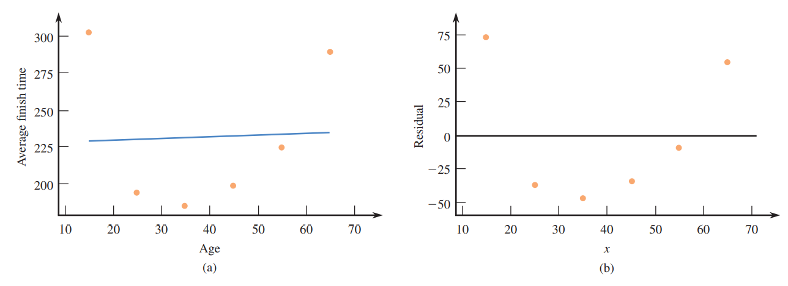
Nonlinear Relationships and Transformation

Slide 5
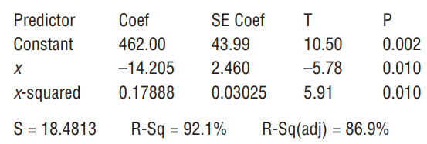

Nonlinear Relationships and Transformation

Slide 6
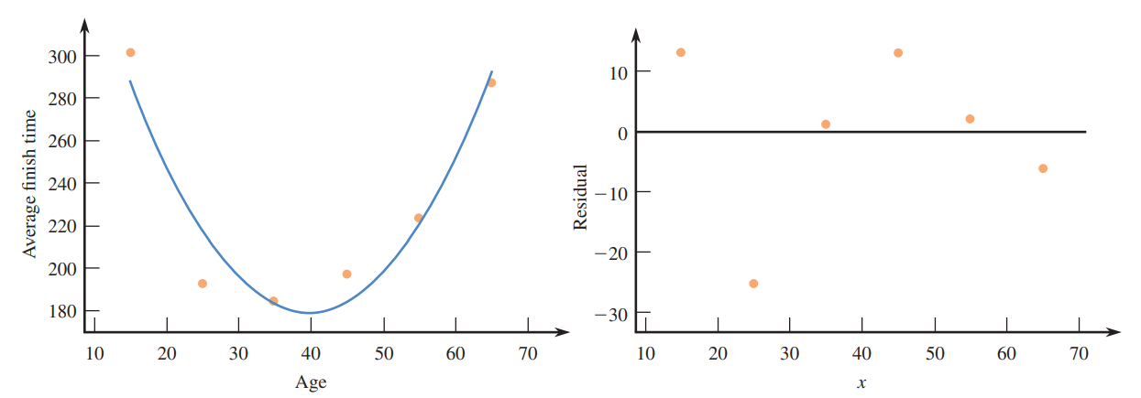
Nonlinear Relationships and Transformation
For the quadratic regression, R-square = 0 .921, which means that 92.1% of the variation in average marathon finish time can be explained by an approximate quadratic relationship between average finish time and age.

Slide 7
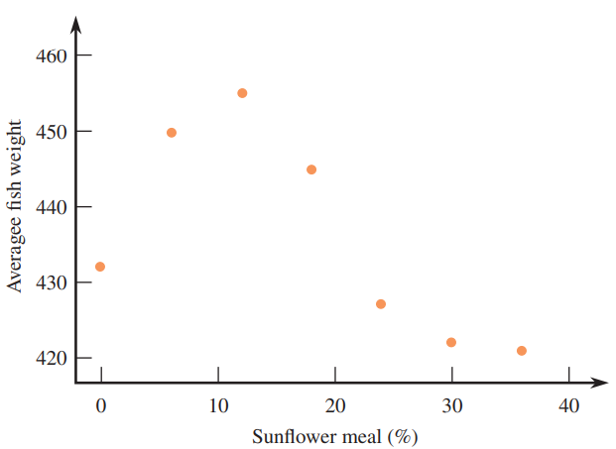
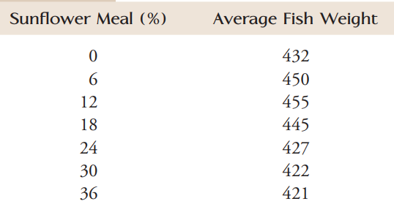
Nonlinear Relationships and Transformation
cubic regression curve……

Slide 8
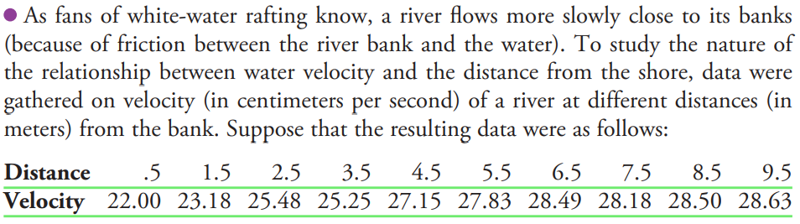
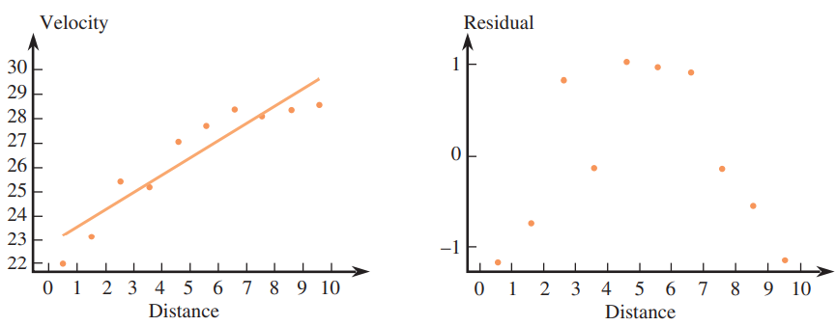

Nonlinear Relationships and Transformation
Try to use x’ to explain y

Slide 9
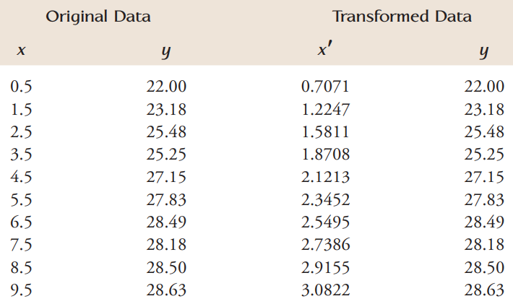

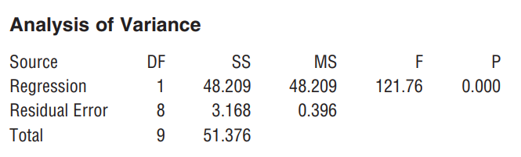
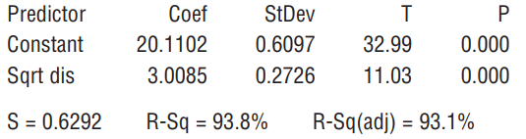
Nonlinear Relationships and Transformation

Slide 10
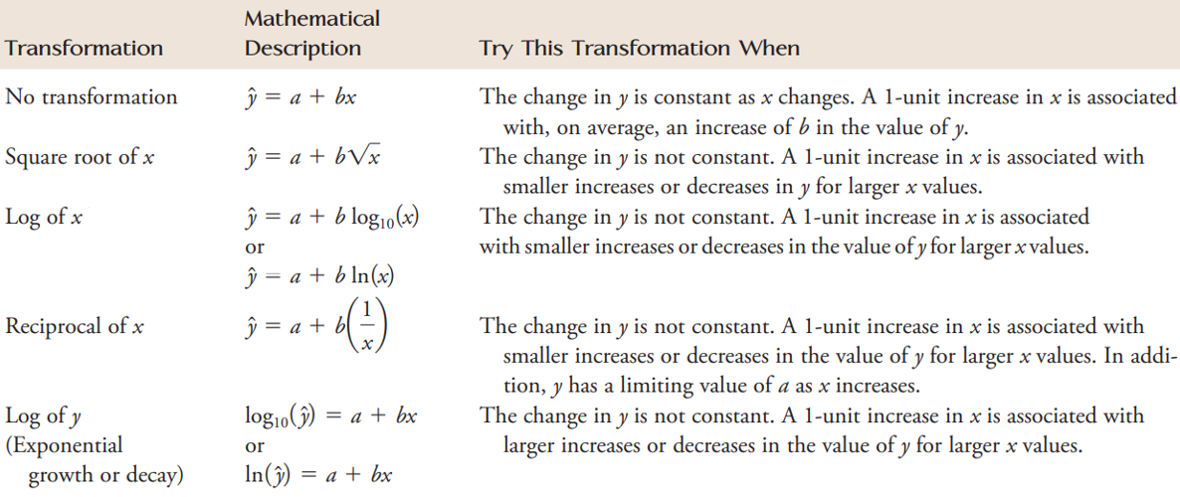
Nonlinear Relationships and Transformation

